Slide 1
GEMS MILLENNIUM SCHOOL SHARJAH
GRADE-12
CBSE RESULT, 2023-2024

Slide 2
GRADE 12 BOARD RESULT
HIGHLIGHTS
113 students appeared
33.63 % of students secured 90% and above (38 Students)
86.72% of students secured 80% and above (98 Students)
97.34% of students secured 75% and above (110 Students)
100% of students passed

Slide 3
GRADE 12 BOARD RESULT
100% PASS IN CBSE GRADE 12 EXAMINATION
SCHOOL AVERAGE 87.3% SCIENCE GROUP AVERAGE 86.9% COMMERCE GROUP AVERAGE 87.8%

Slide 4
GRADE 12 BOARD RESULT
STUDENTS WITH PERFECT 100
NAME | SUBJECT
CHINMAY HALDULKAR | CHEMISTRY
VRISHNVISWA SATHYA MOORTHI | ARTIFICIAL INTELLIGENCE
AMRITHA LAXMI MUKESH | COST ACCOUNTANCY
SANA | INFORMATICS PRACTICE
DIYA LAKSHMI KISHORE KUMAR | MARKETING
SHIVANI VENKATNARAYANAN | PAINTING
ADARA MOHAMMED ANJUM QURESHI | PSYCHOLOGY

Slide 5
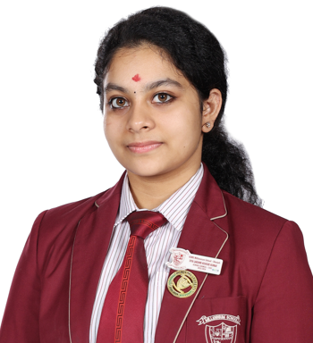
GRADE 12 BOARD RESULT
SCHOOL TOPPER & COMMERCE GROUP TOPPER
DIYA LAKSHMI KISHORE KUMAR
98​%

Slide 6
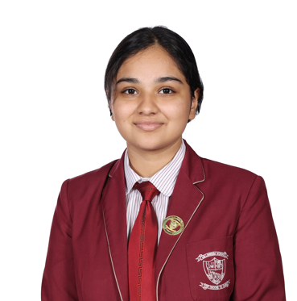
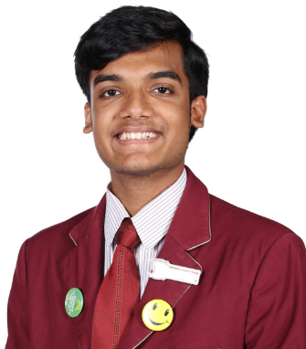
GRADE 12 BOARD RESULT
SCIENCE GROUP TOPPER
SAHARA PAUDEL
96.8​%
ABHIRAM SARITH BHARATH
96.8%

Slide 7
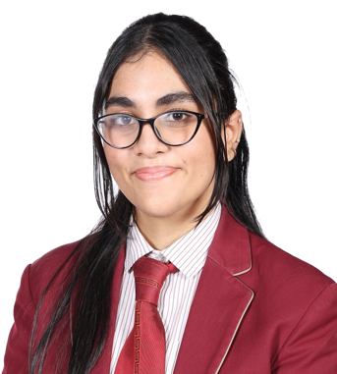
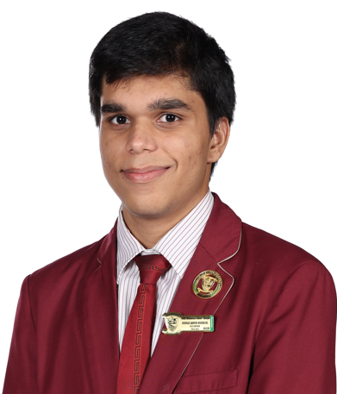
GRADE 12 BOARD RESULT
COMMERCE GROUP TOPPERS WITH 90% AND ABOVE
DIYA LAKSHMI KISHORE KUMAR
98% ​
ADARA MOHAMMED ANJUM QURESHI
96.2% ​
JOSHUA SABHYA RODRICKS
95.8% ​

Slide 8
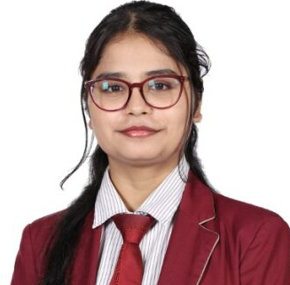
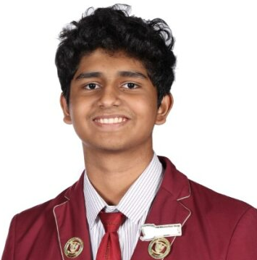
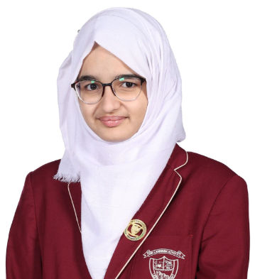
GRADE 12 BOARD RESULT
COMMERCE GROUP TOPPERS WITH 90% AND ABOVE
AYESHA SHAIBAZ BANDRI
95.2% ​
MAYUR PARTHIV SOHANLAL
94.6% ​
SANA
94.6% ​

Slide 9
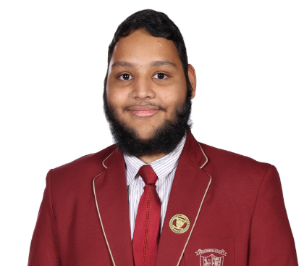
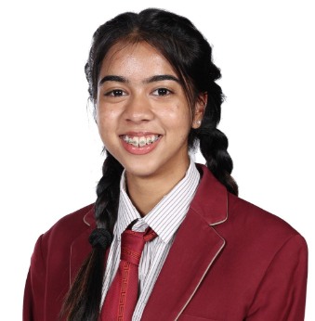
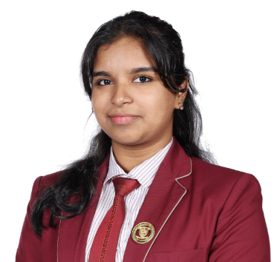
GRADE 12 BOARD RESULT
COMMERCE GROUP TOPPERS WITH 90% AND ABOVE
MURTAZA YUSUF BARODAWALA
94% ​
SANIA GLADSON
93.6% ​
AMRITHA LAXMI MUKESH
93.4% ​

Slide 10
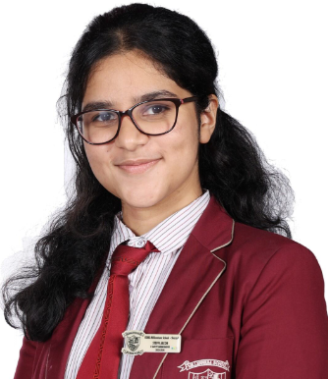
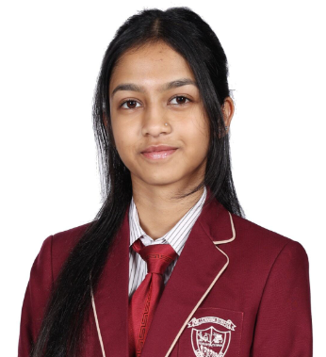
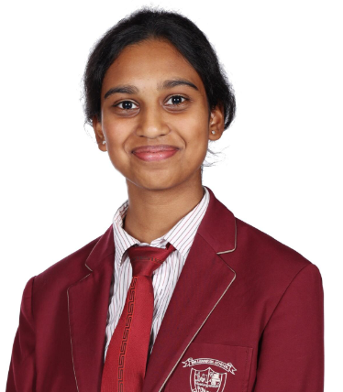
GRADE 12 BOARD RESULT
COMMERCE GROUP TOPPERS WITH 90% AND ABOVE
STEFFI JACOB MATHAI
93.4% ​
RUCHI NITIN DESHMUKH
93.2% ​
KATLYN LINSEY
92.4% ​

Slide 11
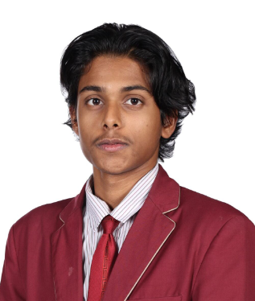
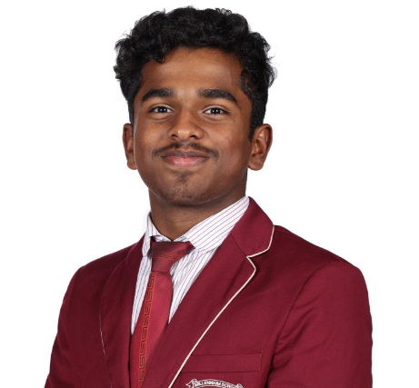
GRADE 12 BOARD RESULT
COMMERCE GROUP TOPPERS WITH 90% AND ABOVE
SOHAM KALYANAM
92.2% ​
MOHAMMAD SHAWAF
91.8% ​

Slide 12
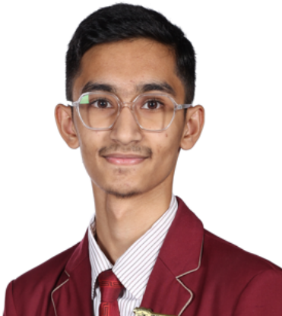
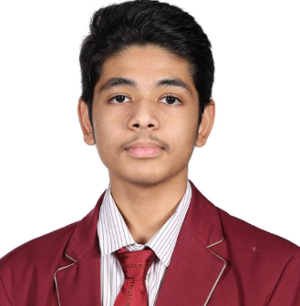
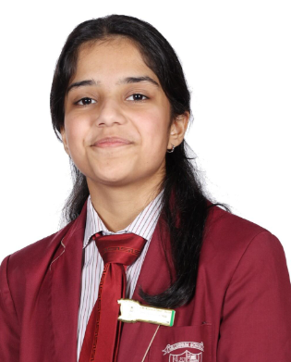
GRADE 12 BOARD RESULT
COMMERCE GROUP TOPPERS WITH 90% AND ABOVE
MUFADDAL MUSTANSIR QUTUB 90.8% ​
SHREYA MANOJ KUMAR GHAGHADA
90.8% ​
PRANAY BAPNA
90.8% ​

Slide 13
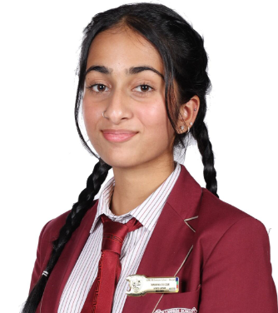
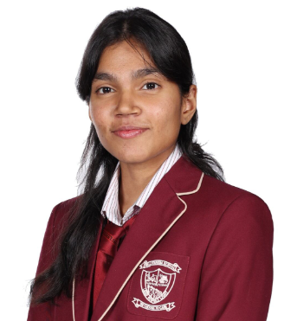
GRADE 12 BOARD RESULT
COMMERCE GROUP TOPPERS WITH 90% AND ABOVE
TAMANNA GULZAR
90.2% ​
ZAFIRAH FATHIMA
90.2% ​

Slide 14
GRADE 12 BOARD RESULT
SCIENCE GROUP TOPPERS WITH 90% AND ABOVE
SAHARA PAUDEL
96.8%
ABHIRAM SARITH BHARATH
96.8%

Slide 15
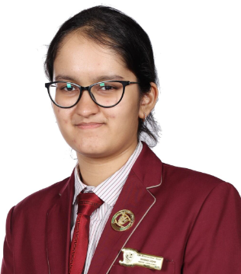
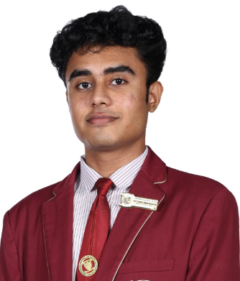
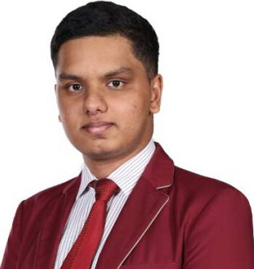
GRADE 12 BOARD RESULT
SCIENCE GROUP TOPPERS WITH 90% AND ABOVE
NIHARIKA SURANA
96.4% ​
SYED ZIDANE IMRAN MUSHTAQ
96.4% ​
VISHAL RAGHAVENDRA
96.4% ​

Slide 16
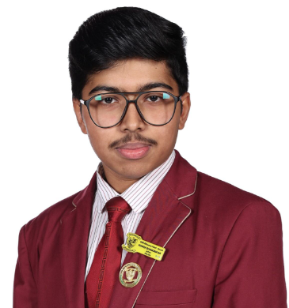
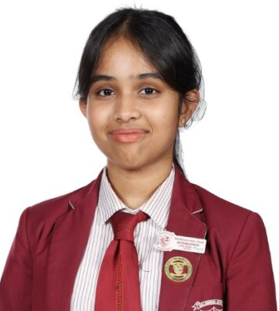
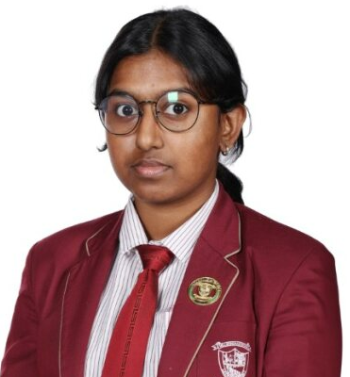
GRADE 12 BOARD RESULT
SCIENCE GROUP TOPPERS WITH 90% AND ABOVE
KRISHNESH KRISHNAKUMAR NAIR
95.8%
KATELYN ANNA RODRIGUES
95.8%
ASHVIKA AUTHITHAN
95.4% ​

Slide 17
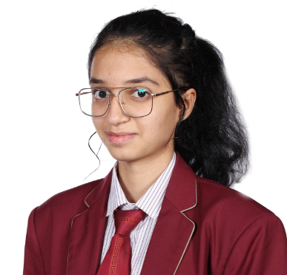
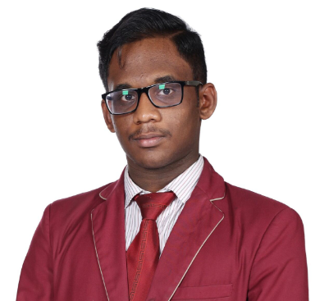
GRADE 12 BOARD RESULT
SCIENCE GROUP TOPPERS WITH 90% AND ABOVE
PRATEEKSHA MAHESH SHET
95.4% ​
SOORYASHANKAR JOY
95.4% ​

Slide 18
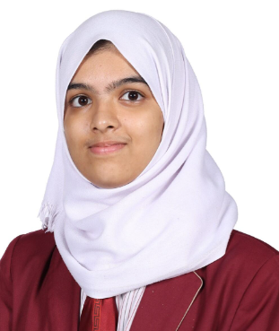
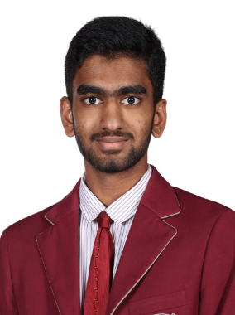
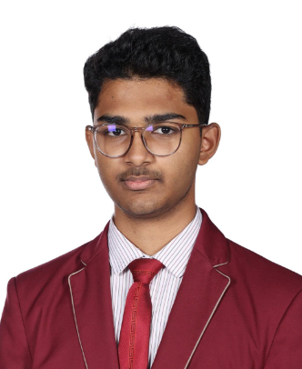
GRADE 12 BOARD RESULT
SCIENCE GROUP TOPPERS WITH 90% AND ABOVE
MARYAM ABDUL AZIZ CHOGLE
95%
CHINMAY HALDULKAR
94.6% ​
SAMUEL JOHN JOSHY
94.6% ​

Slide 19
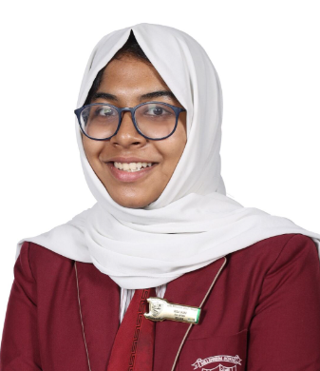
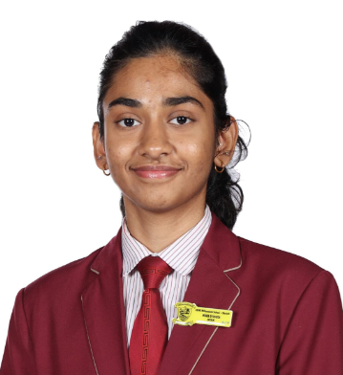
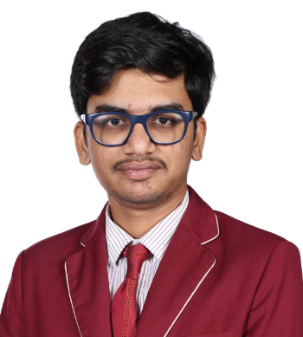
GRADE 12 BOARD RESULT
SCIENCE GROUP TOPPERS WITH 90% AND ABOVE
RIDA KADAVANTHODE SHANI
94.2%
NEIRA NELLIN DSOUZA
94% ​
DHASVANTH MUTHUKUMAR GOKILA
94% ​

Slide 20
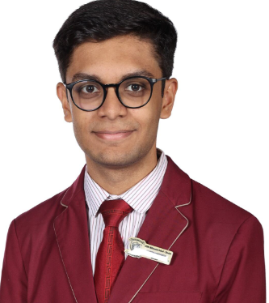
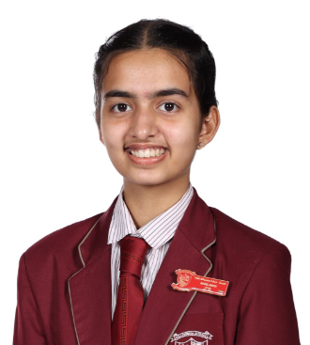
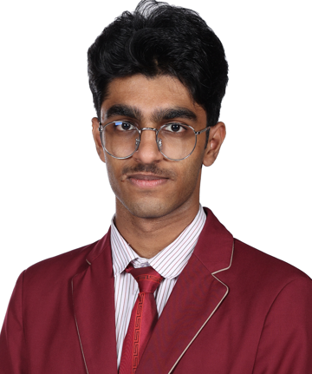
GRADE 12 BOARD RESULT
SCIENCE GROUP TOPPERS WITH 90% AND ABOVE
JAYANTH RAMGANESH
93.6% ​
MIHIKA MANOJ
92% ​
THANMAY PREBEESH
91.6%

Slide 21
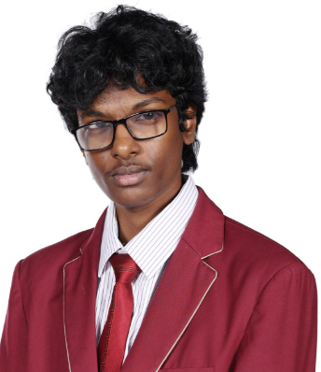
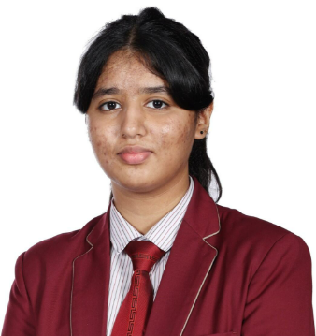
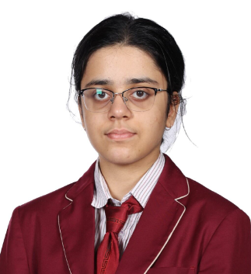
GRADE 12 BOARD RESULT
SCIENCE GROUP TOPPERS WITH 90% AND ABOVE
RISHABH SAI VOBBILICHETTY
91% ​
HANNAH PRINCE CHERIAN
90.6% ​
RAMYA SABHARWAL
90.2% ​

Slide 22
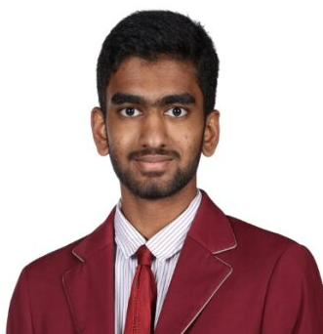
GRADE 12 BOARD RESULT
TOPPER IN CHEMISTRY WITH 100%
CHINMAY HALDULKAR​

Slide 23
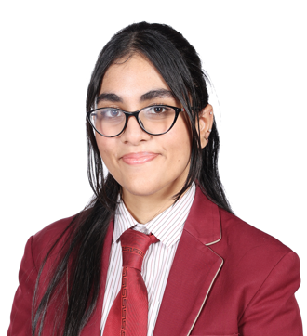
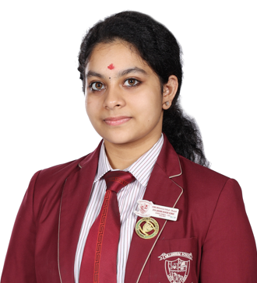
GRADE 12 BOARD RESULT
TOPPER IN PSYCHOLOGY WITH 100%
ADARA MOHAMMED ANJUM QURESHI ​
DIYA LAKSHMI KISHORE KUMAR​

Slide 24
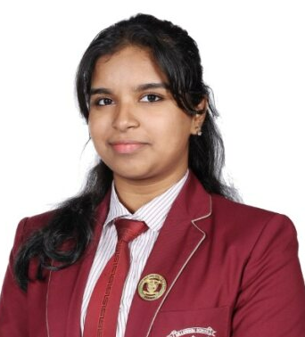
GRADE 12 BOARD RESULT
TOPPER IN COST ACCOUNTING WITH 100%
AMRITHA LAXMI MUKESH​

Slide 25
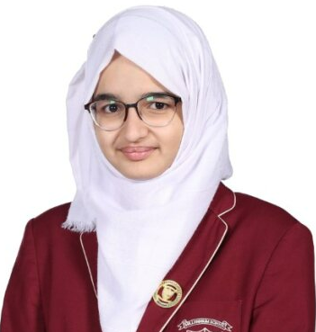
GRADE 12 BOARD RESULT
TOPPER IN INFORMATICS PRACTICES WITH 100%
SANA​

Slide 26
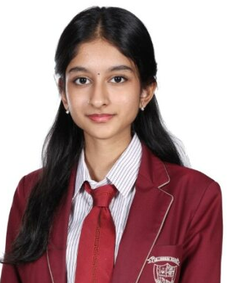
GRADE 12 BOARD RESULT
TOPPER IN PAINTING WITH 100%
SHIVANI VENKATNARAYANAN ​

Slide 27
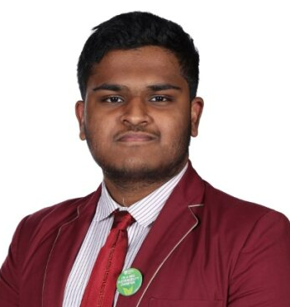
GRADE 12 BOARD RESULT
TOPPER IN ARTIFICIAL INTELLIGENCE 100%
VRISHN VISWA SATHYA MOORTHY​

Slide 28
GRADE 12 BOARD RESULT
TOPPER IN MARKETING WITH 100%
DIYA LAKSHMI KISHORE KUMAR​

Slide 29
GRADE 12 BOARD RESULT
TOPPER IN ENGLISH WITH 99%
DIYA LAKSHMI KISHORE KUMAR ​

Slide 30
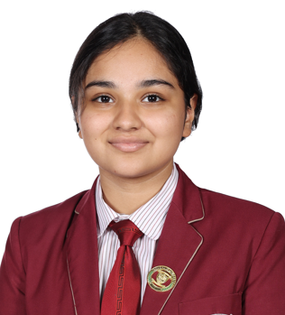
GRADE 12 BOARD RESULT
TOPPER IN BIOLOGY WITH 99%
SAHARA PAUDEL​

Slide 31
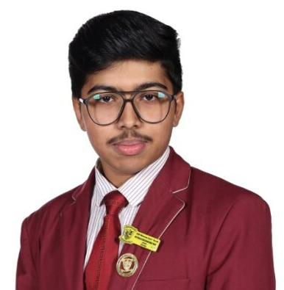
GRADE 12 BOARD RESULT
TOPPER IN COMPUTER SCIENCE WITH 98%
KRISHNESH KRISHNAKUMAR NAIR
SYED ZIDANE IMRAN MUSHTAQ
VISHAL RAGHAVENDRA
PRATEEKSHA MAHESH SHET

Slide 32
GRADE 12 BOARD RESULT
TOPPER IN TYPOGRAPHY &COMPUTER APPLICATIONS WITH 99%
DHASVANTH MUTHUKUMAR GOKILA
​

Slide 33
GRADE 12 BOARD RESULT
TOPPER IN MULTIMEDIA WITH 98%
JOSHUA SABHYA RODRICKS​

Slide 34
GRADE 12 BOARD RESULT
TOPPER IN ACCOUNTANCY WITH 96%
SYED NAILAH JAFRI ​

Slide 35
GRADE 12 BOARD RESULT
TOPPER IN MATHS WITH 96%
SAMUEL JOHN JOSHY

Slide 36
GRADE 12 BOARD RESULT
TOPPER IN BUSINESS STUDIES WITH 95%
ADARA MOHAMMED ANJUM QURESHI ​

Slide 37
GRADE 12 BOARD RESULT
TOPPER IN PHYSICS WITH 95%
KRISHNAKUMAR NAIR
SOORYASHANKAR JOY ​
SAMUEL JOHN JOSHY
VISHAL RAGHAVENDRA NAYAK​

Slide 38
GRADE 12 BOARD RESULT
TOPPER IN PHYSICS WITH 95%
NIHARIKA SURANA
PRATEEKSHA MAHESH SHET​
SAHARA PAUDEL​

Slide 39
GRADE 12 BOARD RESULT
TOPPER IN ECONOMICS WITH 95%
ADARA MOHAMMED ANJUM QURESHI ​

Slide 40
GRADE 12 BOARD RESULT
TOPPER IN PHYSICAL EDUCATION WITH 94%
IMMANEUAL SAMPATH​

Slide 41
GRADE 12 BOARD RESULT

